Slide 1
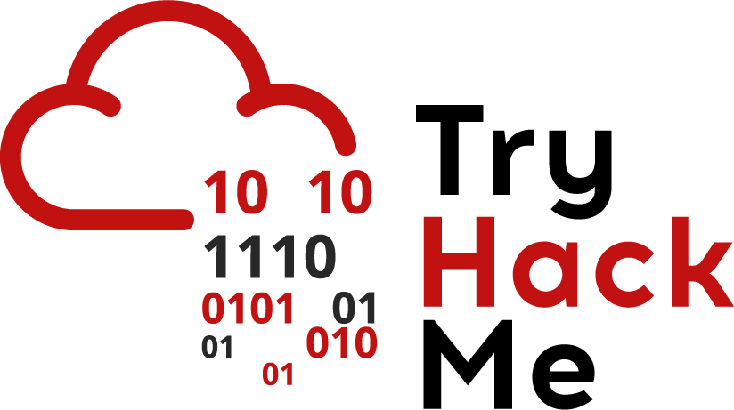


Cyber Kill Chain
Eng. Mahmoud Hassan

Slide 2
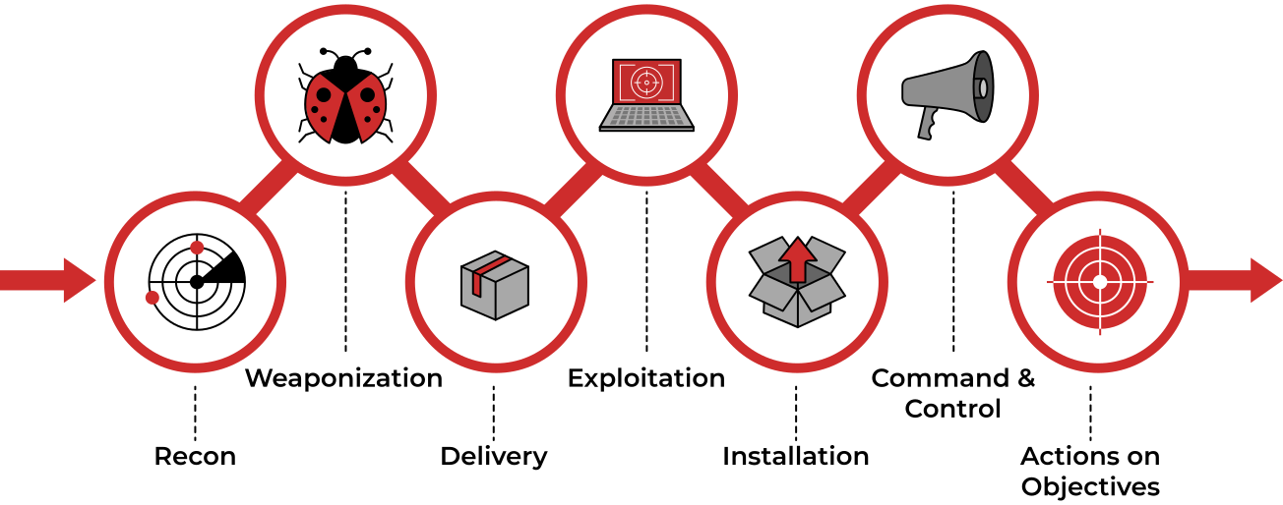
Cyber Kill Chain

Slide 3

Exploitation
The Exploitation Phase:
In this phase, the attacker ("Megatron" in our case) needs to exploit a vulnerability to gain access to the system. In this scenario, "Megatron" got a bit creative and crafted two phishing emails:
1. The First Email: Contains a phishing link leading to a fake Office 365 login page. If the victim enters their credentials, the attacker can steal this information.
2. The Second Email: Contains a macro attachment that executes ransomware as soon as the victim opens the file.
"Megatron" successfully convinced two victims to click on the malicious link and open the malicious file, allowing him to gain access to their systems.

Slide 4
Exploitation
After Initial Access:
Once the attacker gains access to the system, they can exploit more vulnerabilities in software, systems, or servers to achieve the most important two goals for him:
1. Privilege Escalation: Gaining higher-level permissions to take full control of the system.
let's see some of these vulnerabilities:
1. Software Vulnerabilities: Vulnerabilities in operating systems or applications.
2. DLL Injection: Placing a malicious DLL where a privileged application expects a legitimate one.
3. Binary Hijacking: Exploiting misconfigured system paths to execute unauthorized code.

Slide 5
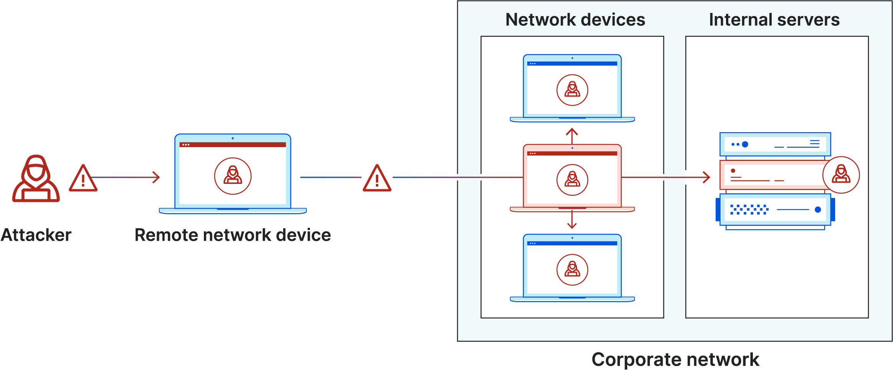
Exploitation
After Initial Access:
Once the attacker gains access to the system, they can exploit more vulnerabilities in software, systems, or servers to achieve one of the following goals:
2. Lateral Movement: Moving deeper into the network to access other devices or systems containing sensitive data.

Slide 6
Exploitation
What is a Zero-day Exploit?
A Zero-day vulnerability is an unknown vulnerability that has no patch yet. According to FireEye, exploiting this vulnerability leaves the system exposed to attacks with no opportunity for detection initially.
Example:
If an attacker discovers a vulnerability in a software program and exploits it before the developer is aware of it, this is called a Zero-day Exploit.

Slide 7



Thank you
+201116735630
mahmoudhassan2947@gmail.com
www.linkedin.com/in/mahmoud-hassan-b4400b1b7

